Slide 1
Relax Inc. Take-home challenge
By: Christopher Le

Slide 2
Problem Statement
How can Relax Inc. identify which factors predict future user adoption?

Slide 3
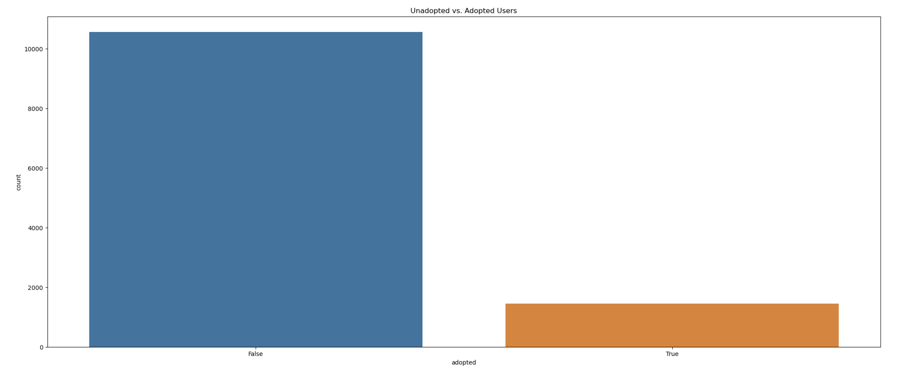
Distribution of Adopted vs. unadopted users

Slide 4
Predictive Modeling
Utilized a random forest classifier model
The final model was had a 96.61% training accuracy, but only a 81.06% testing accuracy.
The large gap between training and testing accuracy as well as the AUC score of 51.38% suggests that the model was overfitting and was not able to generalize well to the testing data.
Significant class imbalance in target variable

Slide 5
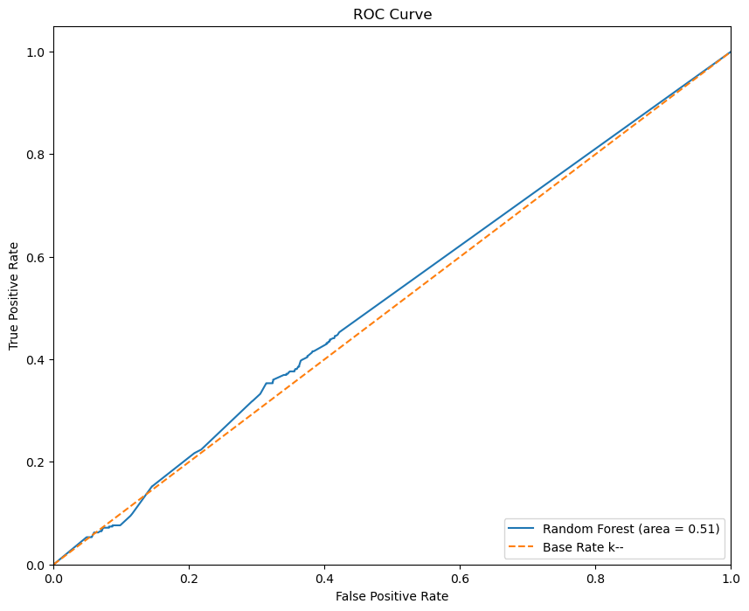
Richard Branson

Slide 6
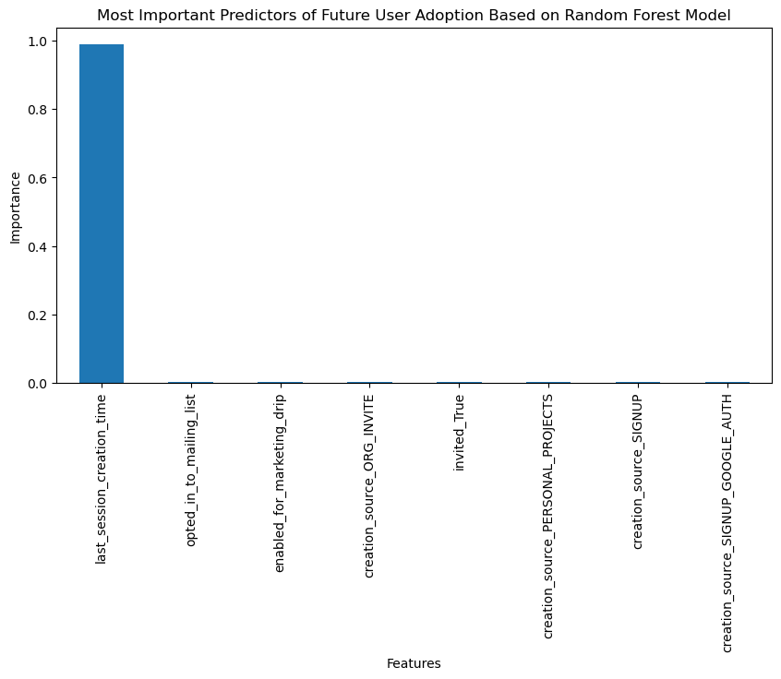

Slide 7
Recommendations
The best predictors of future user adoption are:
- `last_session_creation_time`: the most important predictor of future user adoption was when the user last logged in. This make sense since users who did not log in recently would probably not be adopted users. It also be noted that there was some missing data that we filled in with 0 for this variable.
- `opted_in_to_mailing_list`: the next best indicator were for users who opted into receiving the mailing emails.
- `enabled_for_marketing_drip`: users who enabled for the regular marketing drip were also more likely to be adopted.
- `creation_source_org_INVITE`: another important indicator were users who created their account because they were invited by an organization.

Slide 8
THANK YOU
Chris Le

